Slide 1
ECO_AI
Using AI to reduce energy consumption

Slide 2
Presentation Outline
This Presentation Contains
An overview of our application
Our Applications features
Analysis of the collected data, and our team’s identified solutions to reducing the school consumption
Appendix: Application Usage Instructions
Appendix: Technical Explanation of the Software

Slide 3
Project Overview
Our team collected data that indicated the average amount of energy used by each appliance over a 24 hour period at St. Joseph Secondary School, Mississauga.
We developed a visual software program to analyze and display collected data.
Using this information, our groups Identified impactful solutions to help reduce the energy consumption of the building.

Slide 4
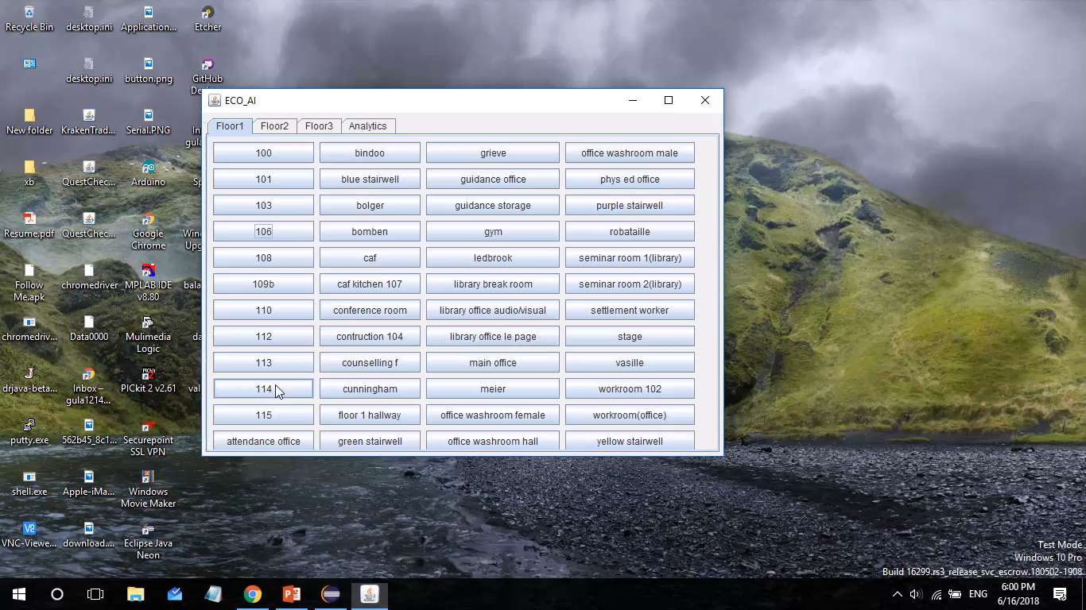
Our Product
Our Software shows the energy consumption of each appliance, classroom, and floor with an easy to use interface
It analyses the schools consumption data and identifies easy solutions to reduce the school consumption

Slide 5
With our software you can:
See the energy consumption of every appliance, classroom, and floor on the school
See which appliances and classrooms draw the most energy, and easily compare them through descriptive graphs
See how much the school must pay for its electricity consumption
Find potential solutions that will reduce the energy consumed by the school
And much more….

Slide 6
Our Team’s Goal
Through data collection of the school’s energy consumption our goal is to create a plan of action can be taken by the school and its allies to:
Reduce negative ecological impact the school’s energy consumption has on climate change and trees
CO2, alongside other greenhouse gases, are emitted from the consumption of electrical energy resulting in climate change and an overall imbalance of the biosphere.
460.6236 CO2e emitted by the school on a daily basis, which accumulates into dangerous amounts overtime.
Trees absorb an average of 12kg of CO2 a year
Limit the cost of energy so the school has more money available for education related materials and/or programs

Slide 7
Considerations for Pre-analysis of Data
The measured appliances have a specific wattage which can be multiplied by the amount of time they are running (in one day) to be converted to kWh, a unit of measure which shows the relationship between the specific energy of an appliances and the time it is run on.
Hallway lights must remain on at all times as the school requires some sort of constant source of light
Some kitchen appliances, such as refrigerators, must remain in operations at all times. The reduction of energy for these appliances is therefore not applicable

Slide 8
Results
Total School Consumption – Quantity and Cost
Consumption of each appliance type
School daily consumption: 2559.02kWh
Most energy consuming classroom: Floor 1 hallway (140.52kWh)
Daily cost of energy: $2559.02
Monthly energy cost: $56298.51
LIGHT: 1526.62kWh
KITCHEN APPLIANCES: 605.66kWh
ELECTRONICS: 275.10kWh
COMPUTERS: 108.28kWh
MISCELLANIOUS: 43.35kWh
Most energy consuming appliance: LIGHTS

Slide 9
Results – Format and its Significance
Appliances run under a 24 hour cycle which varying spans of time in which they are operating. The value of the school’s daily energy consumption not only allows for a simple relation between the time appliances are running and with what quantity of energy they are doing so, but also allows for a more impactful representation of the amount of energy the school consumes in a larger span of time.
Indication of the most energy consuming classroom and appliance to allow for a more detailed and effective data analysis as more focus will be geared towards this fact.
Both daily and monthly costs of school’s energy consumption to put into perspective how the daily cost is able to accumulate into a much larger quantity in a relatively short amount of time

Slide 10
Our Solution to Reduce Energy Consumption: Lights
Lights are the major contributing factors to the school’s quantity of energy consumption.
To ensure that electricity is not wasted on the operation of lights new rules can be installed:
Office and Classroom lights should remain off only if a class session is in progress, the office is occupied by its owner, or a custodian is cleaning the room. In any case, efforts to keep lights not turned off whenever possible is highly recommended.
To ensure this plan remains in place, routine checks of the operation of lights in rooms which are not in operation should be implemented to turn off lights if they are in operation in an unoccupied room.
The installment of “lights-off” activities that occur at certain planned times over the course of a school year in which all classrooms and offices turn off their lights the whole day further limits the electrical energy consumption of the school.

Slide 11
Our Solution to Reduce Energy Consumption: Kitchen Appliances, Electronics, Computers, and Miscellaneous
Although the energy consumption of lights account for most of the schools energy consumption, other appliances who contribute to this amount cannot be ignored.
Kitchen appliances should be unplugged when not in use. This applies to items such as toasters that do not need to be kept on at all times.
Teachers and students should bring foods that do not require any sort of electrical appliance to either cool or heat to limit the usage of these appliances.
Electronic devices such as projectors should not be running if not being used. In addition to this, if a teacher has access to a black or white board they should use that instead of their projector if their lesson complies.
Computers should remain off if not being used.
Routine checks should be done to ensure that computers not in operation by an individual remain off.

Slide 12
Analysis - Alternative Options for a Brighter Future: LED lights
Considering that lights are the most energy consuming appliance and the most energy consuming room is the first floor hallway which is composed of multiple variations of lights, an approach to fix the root of the problem may be necessary.
Alternatives to the Fluorescent, incandescent, and CFL lights currently in the school are LED lights, which use substantially less energy.
Despite their large price, they last substantially longer than the lights already in place at the school and will be a permanent adjustment which will reduce the school’s ecological impact.

Slide 13
Final Amalgamation of Information
Through the use of computer technology, the collection and organization of information pertaining to energy consumption of the school was executed with the aid of an interactive, user-friendly program.
Impactful solution, both on part by school faculty and students, have been identified through the analysis of this organized data in hoped of reducing the school’s ecological impact their energy consumption has while also limiting the cost of this consumption.

Slide 14
Appendix: Software Operation Guide
The following slides will explain all of the features of the program and how they can be used to limit the school’s energy consumption

Slide 15
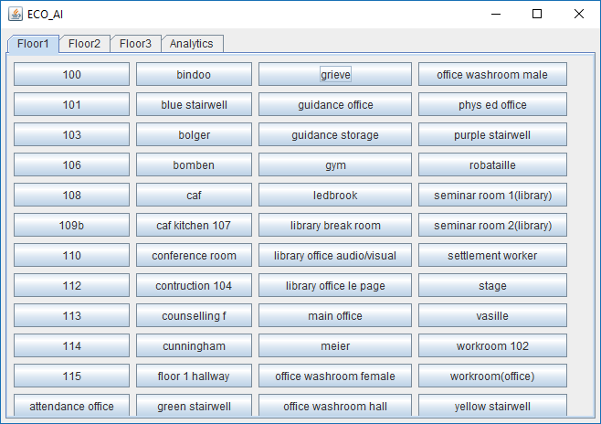
These three tabs will show the show all of the rooms on the selected floor
This tab will show overall statistics of the school
Clicking each button will show energy details about that room
This is the application’s main page

Slide 16
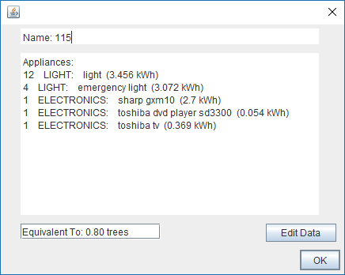
List of all appliances in the classroom and their consumptions
Click on the button to edit any of the data above
Displays the number of trees that must be planted to recover the classroom’s consumption in a day

Slide 17
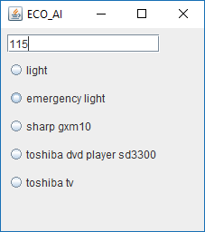
Select the appliance you wish to edit

Slide 18
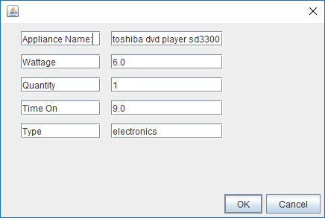
Edit the fields on the right to change their values
Hover your mouse over the fields on the left to find out what they mean
Click ok to save your changes

Slide 19
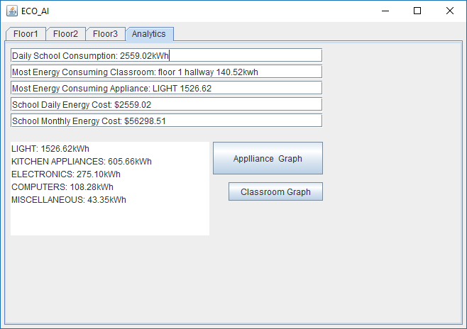
These boxes display an analysis of the data, hover your mouse over them to find out what they mean
Clicking on these buttons will show a graph comparing the energy consumption of the appliance types or the 20 most consuming classrooms in the school. (ONLY ONE BUTTON MAY BE PRESSED EVERY TIME THE APPLICATION IS OPENED)

Slide 20
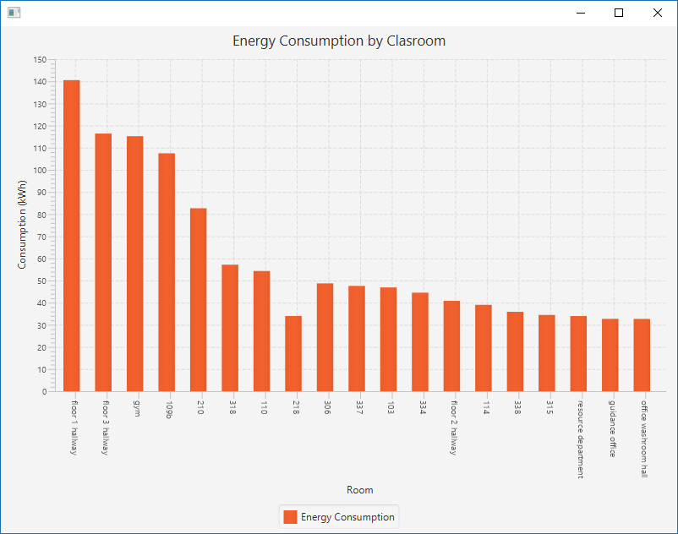

Slide 21
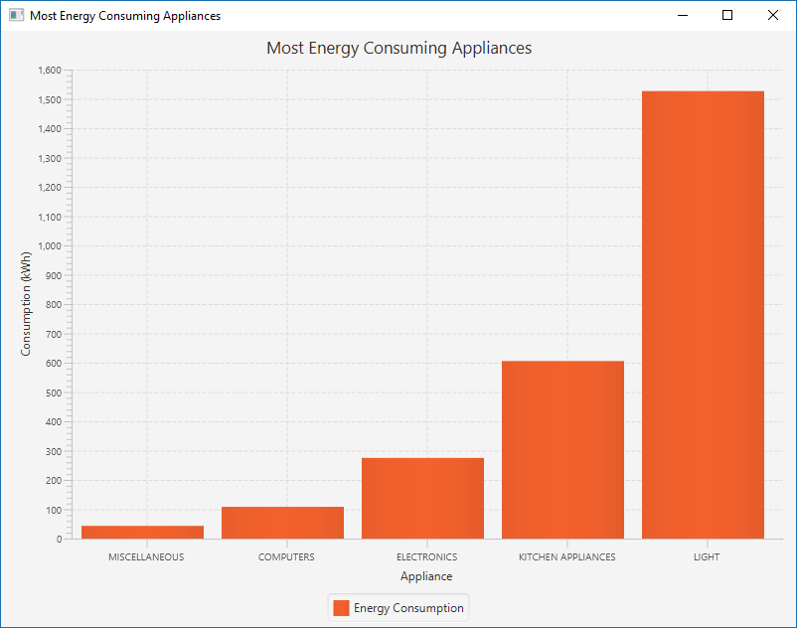

Slide 22
Appendix: Technical Explanation of the Software
Our program features a graphical User-Interface that allows easy access to the collected data.
The user interface allows the user to select and view the energy consumption by department, room, floor, and/or appliance.
Our program contains an analytics page where it analyzes the data and displays the most energy consuming rooms and appliances and the school’s costs for electricity.
These analytics, in a combined effort, aid in the identification of the most effective solutions to minimize the school's energy consumption for the reduction and elimination of any potential environmental issues.

Slide 23
Program Structure
class School
class MainPrg
class Floor
class Classroom
class Appliance

Slide 24
Class Structures
Method Descriptions –
calcSchoolConsumption: Calculates and returns the total energy consumption of the school.
calcApplianceTotal: Calculates and returns the sum of the consumption for all the appliances of the specified type of the school.
populateApplianceType: Finds and returns appliance info.
FindMaxClassroom: Calculates and return the classroom with the largest energy consumption of the school.
calcPrice: Calculates and returns the cost of the entire school’s energy consumption.
calcTrees: Calculates and returns the approximate amount of trees required to absorb the amount of GHG emissions resulted from an energy consumption
class School
- ArrayList <Floor> floors
- Map<Double,String> applianceConsumption
//constructors
//get-set methods
+ calcSchoolConsumption(): double
+ calcApplianceTotal(ApplianceType): double
+ populateApplianceType(): void
+ findMaxClassroom(): Classroom
+ calcPrice(): double
+ calcTrees(double): double
Notes:
School: JY
calcSchoolConsumption(): finds consumption of entire school
calcApplianceTotal(ApplianceType): calculates the sum of the consumption for all the appliances of the specified type
findMaxApplianceType(): return the appliance type with the most energy consumption
findMaxClassroom(); return the classroom with the largest energy consumption
Floor: Blake
calcFloorConsumption(): calculate the total consumption of the floor
findMaxClassroom(): returns the classroom on the floor with the largest consumption
Classroom: David
calcClassConsumption():finds total consumption of the classroom
findMaxApplianceType(): returns the applianceType of the appliance drawing the most energy in the class

Slide 25
Class Structures
Method Descriptions –
calcFloorConsumption: Calculates and returns the total energy consumption of the specified floor.
FindMaxClassroom: Calculates and return the classroom with the largest energy consumption of the specified floor.
calcPrice: Calculates and returns the cost of the specified floor’s energy consumption.
class Floor
- int floorNumber
- ArrayList <Classroom> classrooms
//constructors
//get-set methods
+ findMaxClassroom(): Classroom
+ calcFloorConsumption(): double
+ calcPrice(): double

Slide 26
Class Structures
Method Descriptions –
calcClassConsumption: Calculates and returns the total energy consumption of the specified classroom.
FindMaxApplianceType: Calculates and return the appliance type with the largest energy consumption of the specified classroom.
calcPrice: Calculates and returns the cost of the specified classroom’s energy consumption.
toString: returns the class consumption with units.
class Classroom
- String name;
- ArrayList <Appliance> Appliances
- double consumption
//constructors
//get-set methods
+ calcClassConsumption(): double
+ findMaxApplianceType(): Map<String, Double>
+ calcPrice(): double
+ toString(): String

Slide 27
Class Structures
Method Descriptions –
calcDailyConsumption: Calculates and returns the daily energy consumption of the specified appliance.
calcPrice: Calculates and returns the cost of the specified appliance’s daily energy consumption.
toString: returns the appliance information.
class Appliance
- String name;
- int quantity;
+ String type;
- double hourlyConsumption;
- double timeOn;
//constructors
//get-set methods
+ calcDailyConsumption():double
+ calcPrice(): double
+ toString(): String

